Slide 1




Development of master curricula for natural disasters risk management in
Western Balkan countries
NatRisk
WP6: Dissemination results
Dejan Rančić
University of Niš, Faculty of Electronic Engineering
Training of teaching staff for innovative teaching methods/ 19th to 21st September 2017.
Project number: 573806-EPP-1-2016-1-RS-EPPKA2-CBHE-JP
"This project has been funded with support from the European Commission. This publication reflects the views only of the author, and the Commission cannot be held responsible for any use which may be made of the information contained therein"

Slide 2
Topics
Development of master curricula for natural disasters risk management in Western Balkan countries
Dissemination activities already accomplished from the beginning of the Project.
Recent dissemaination activities.

Slide 3
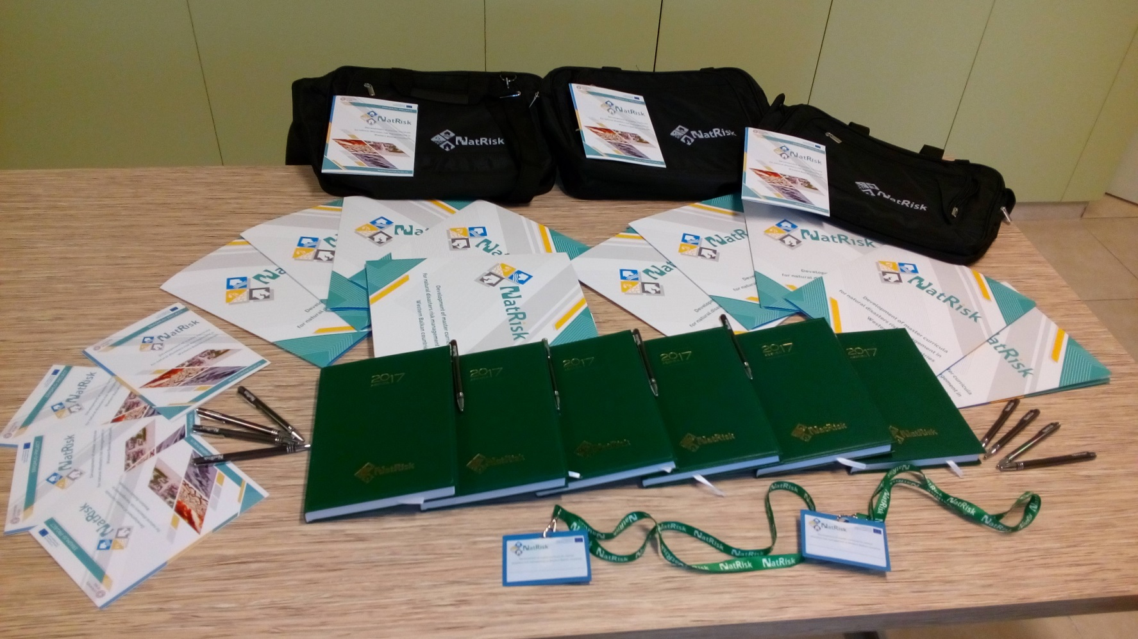
Visual identity (promotion material)
Development of master curricula for natural disasters risk management in Western Balkan countries

Slide 4
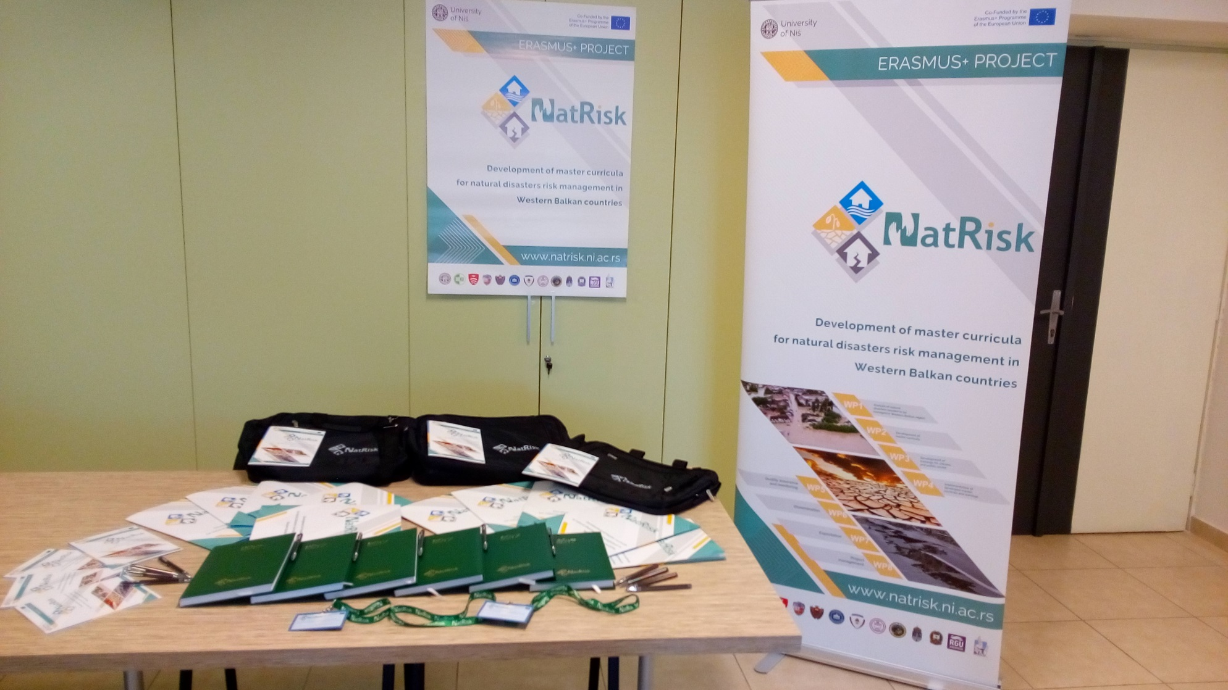
Development of master curricula for natural disasters risk management in Western Balkan countries

Slide 5
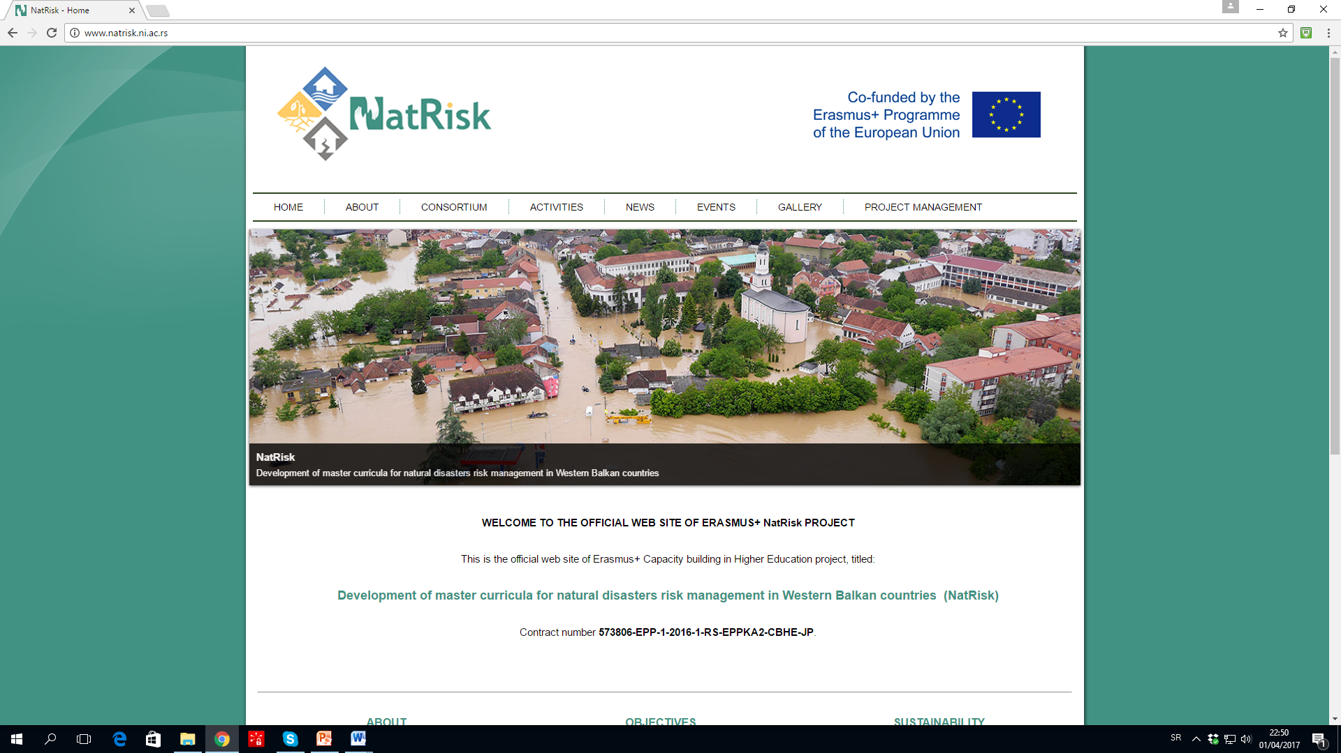
Development of master curricula for natural disasters risk management in Western Balkan countries
NatRisk website
www.natrisk.ni.ac.rs

Slide 6
Social network profile - FB
Development of master curricula for natural disasters risk management in Western Balkan countries

Slide 7
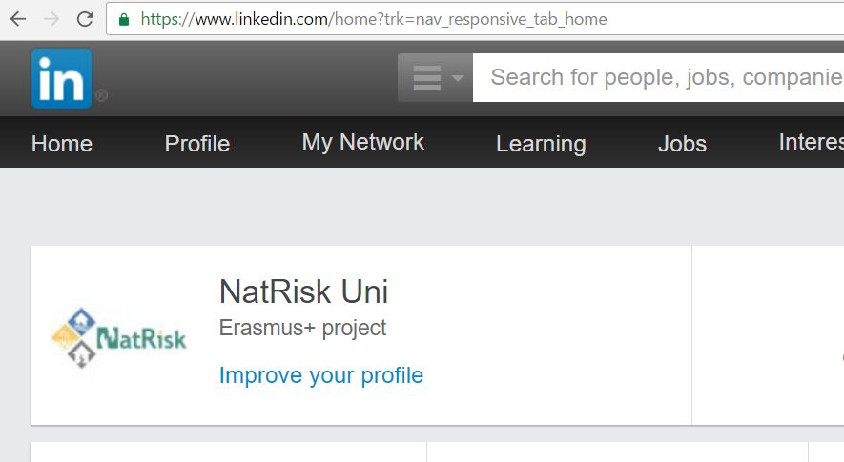
Social network profile - LinkedIn
Development of master curricula for natural disasters risk management in Western Balkan countries

Slide 8
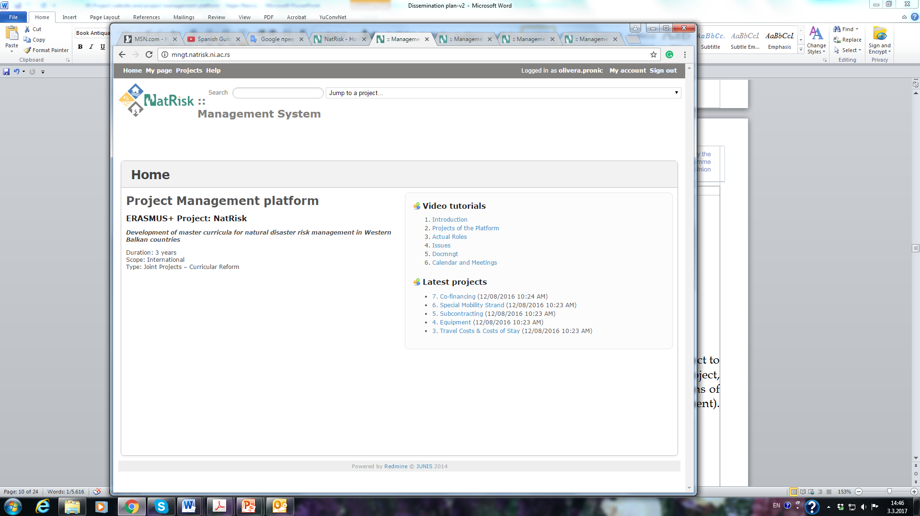
Development of master curricula for natural disasters risk management in Western Balkan countries
Project Management Platform

Slide 9
Development of master curricula for natural disasters risk management in Western Balkan countries
Updated NatRisk website
www.natrisk.ni.ac.rs

Slide 10
Development of master curricula for natural disasters risk management in Western Balkan countries
NatRisk YouTube channel

Slide 11
Development of master curricula for natural disasters risk management in Western Balkan countries
NatRisk Instagram profile

Slide 12
Development of master curricula for natural disasters risk management in Western Balkan countries
Press releases
May 2017 | Survey of citizens’ and public sector awareness created Catalogue of competencies created Report on master curricula best practices in EU partner countries created
March 2017 | Report on natural disasters in the Western Balkans created
March 2017 | Report on established practices in EU countries for natural disaster risk management (NDRM)
October 2016 | NatRisk project launched

Slide 13


Development of master curricula for natural disasters risk management in Western Balkan countries
Presentations & Publications
Presentations
 | Project presentation in English Project presentation in Serbian
Publications
 | Izvestaj o anketi o svesnosti gradjana i javnog sektora Report on survey of citizens and public sector awareness Report on established practices in EU countries for NDRM Report on natural disasters in WB Catalogue of competencies Report on master curricula best practices in EU partner countries

Slide 14
Development of master curricula for natural disasters risk management in Western Balkan countries
Conferences / Workshops / Meetings
12 July 2017 | Συνάντηση εταίρων προγράμματος ΝatRisk στην Πολυτεχνειούπολη
21 June 2017 | Једнодневна обука за управљање ризицима у случају природних катастрофа
9 June 2017 | Promocija NatRisk projekta na Univerzitetu Crne Gore
25 May 2017 | Study visit and training of teaching staff in London (June 28-30, 2017)
23 May 2017 | Promotion of NatRisk project at the forum Resilience as a Base of Security Culture
23 May 2017 | Promotion of NatRisk project at the Scientific and professional conference “POLICE AND JUDICIARY AS GUARANTEES OF FREEDOM AND SECURITY IN A LEGAL STATE”
15 May 2017 | Promocija NatRisk projekta na Građevinijadi 2017
24 April 2017 | Promotion of NatRisk project at the Fourth conference Green building
29 November 2016 | Promotion of NatRisk project at Staff training week Erasmus+: Careers and Cultures

Slide 15
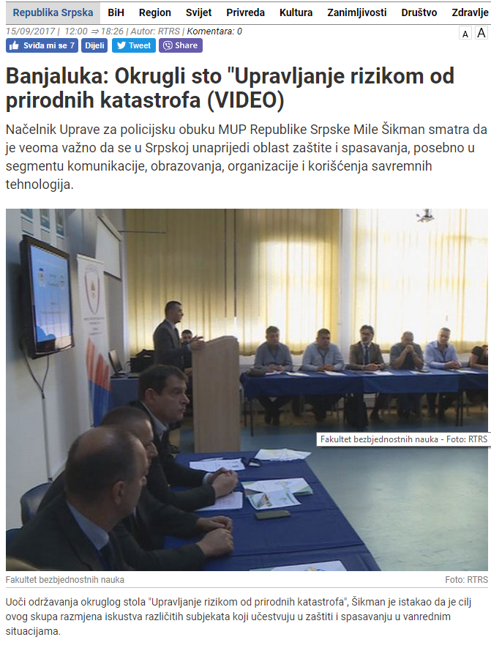
Development of master curricula for natural disasters risk management in Western Balkan countries
Newspapers and magazines

Slide 16
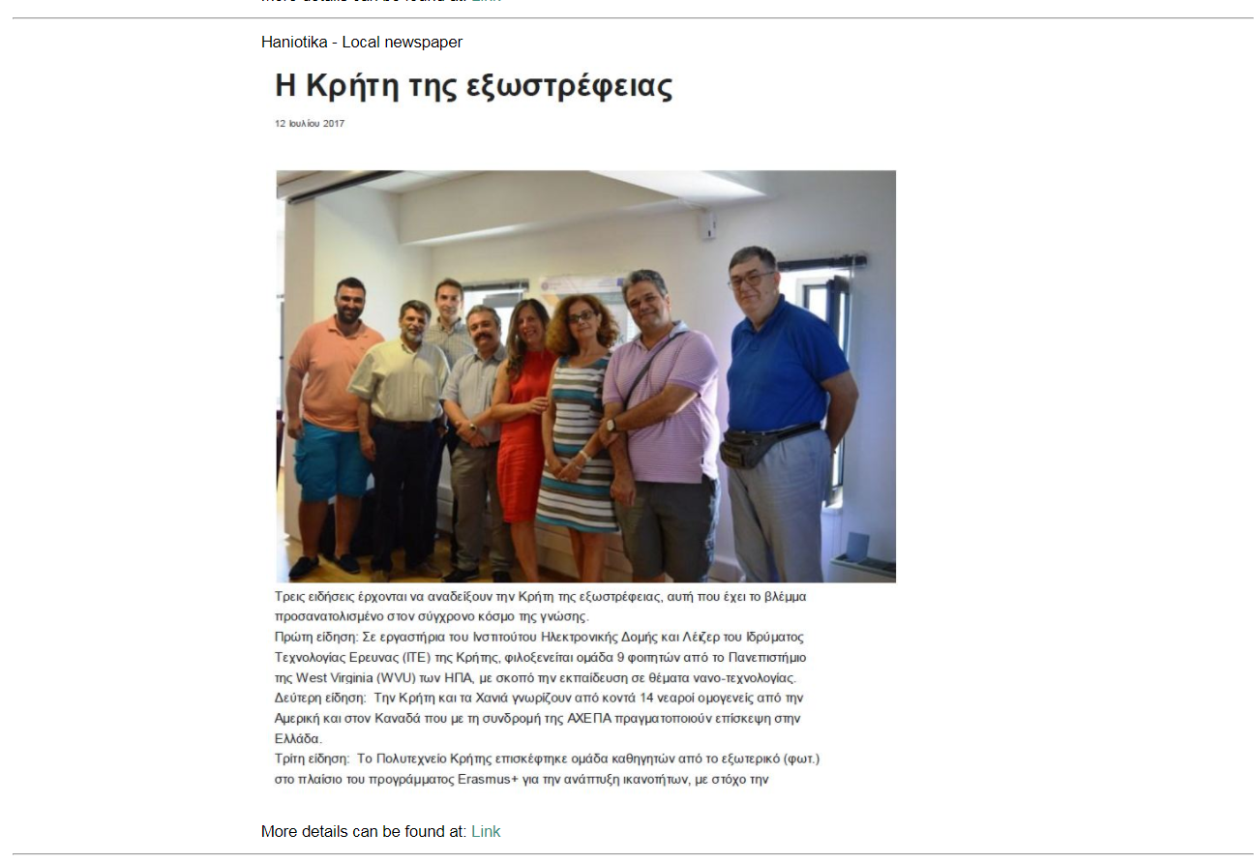
Development of master curricula for natural disasters risk management in Western Balkan countries
Newspapers and magazines

Slide 17
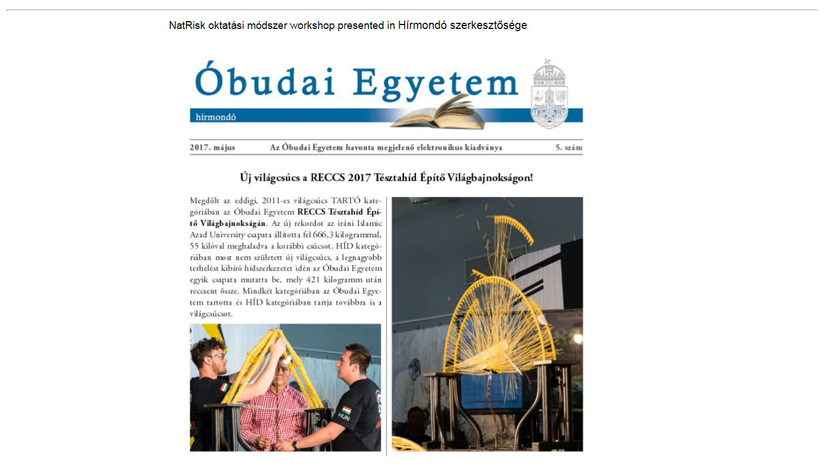
Development of master curricula for natural disasters risk management in Western Balkan countries
Newspapers and magazines

Slide 18
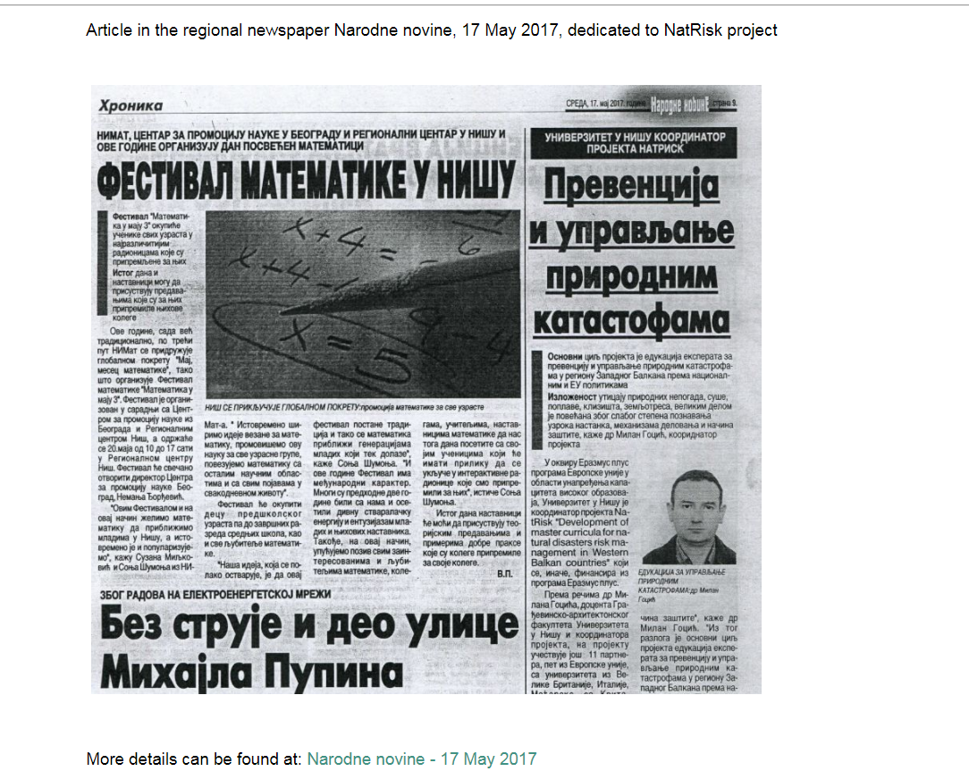
Development of master curricula for natural disasters risk management in Western Balkan countries
Newspapers and magazines

Slide 19
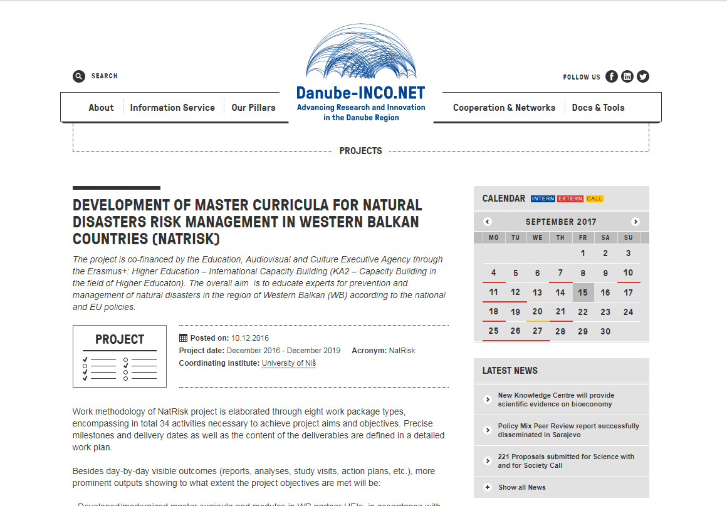
Development of master curricula for natural disasters risk management in Western Balkan countries
Newspapers and magazines

Slide 20
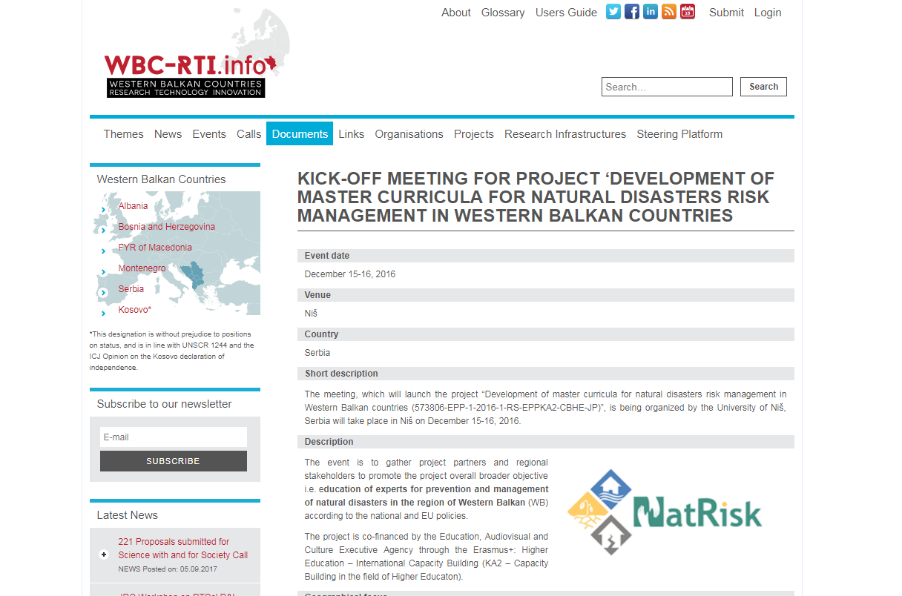
Development of master curricula for natural disasters risk management in Western Balkan countries
Newspapers and magazines

Slide 21
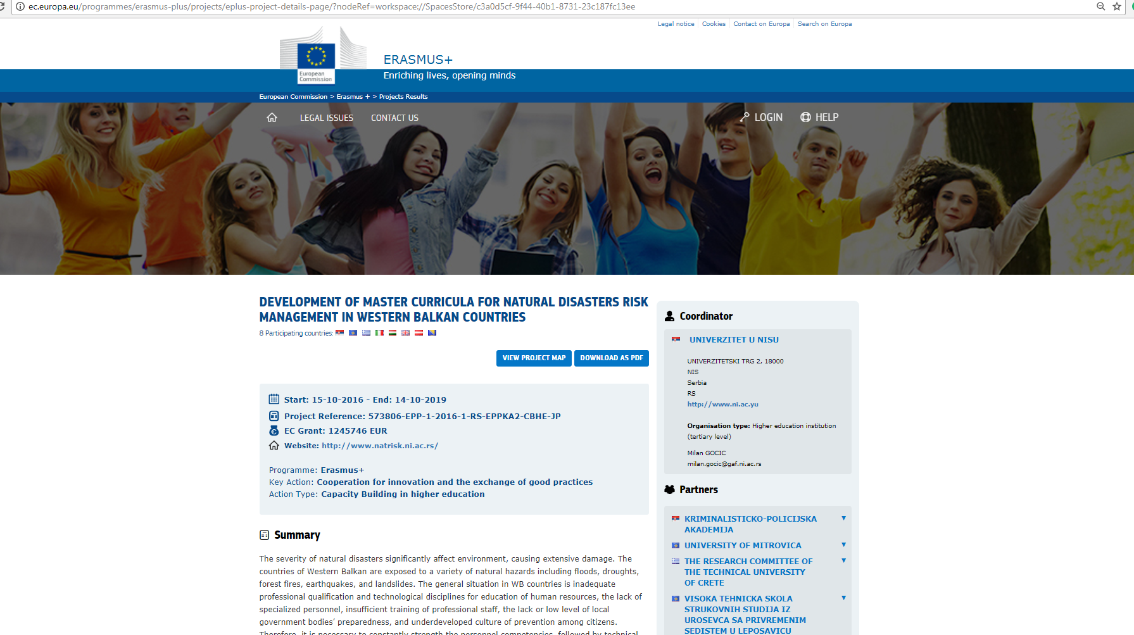
Development of master curricula for natural disasters risk management in Western Balkan countries
NatRisk on ERASMUS+

Slide 22
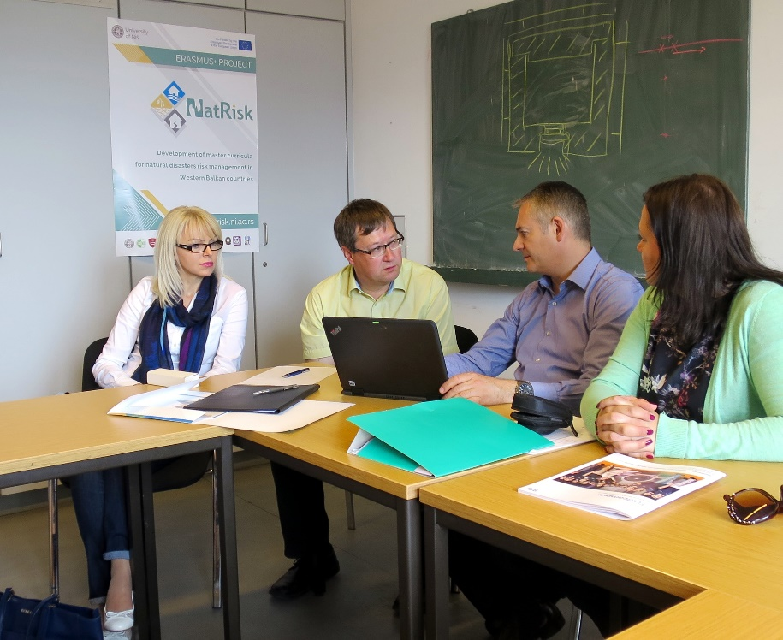
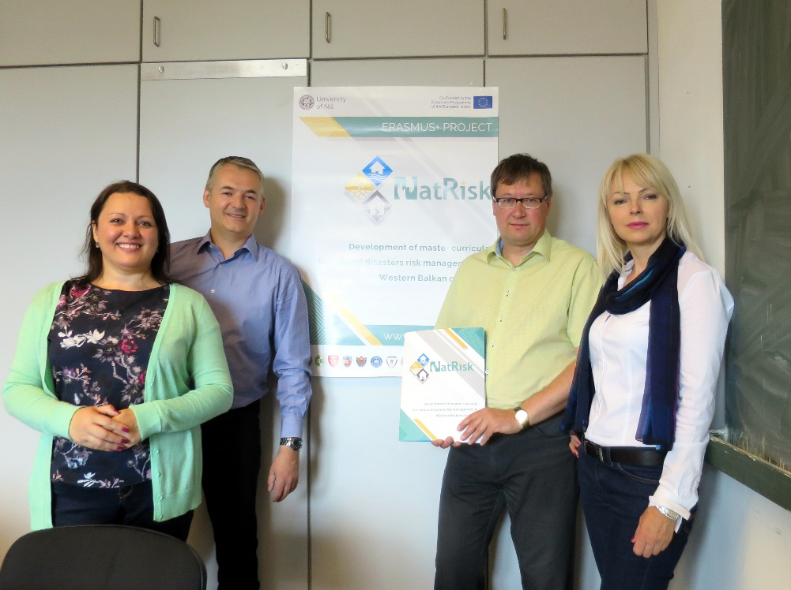
Development of master curricula for natural disasters risk management in Western Balkan countries
NatRisk Promotion
Meeting of DAAD project Flood prediction and alerting system in TUM, Munich, Germany – May 2017

Slide 23
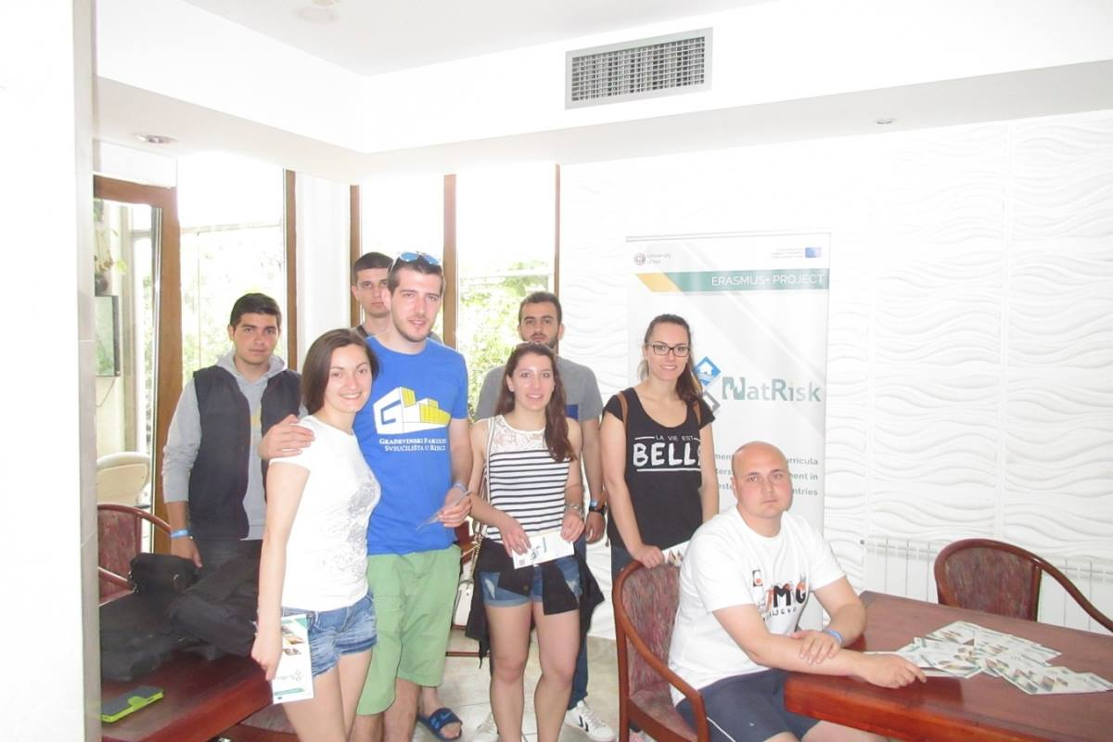
Development of master curricula for natural disasters risk management in Western Balkan countries
NatRisk Promotion
Gradjevinijada in Budva, Montenegro– May 2017

Slide 24
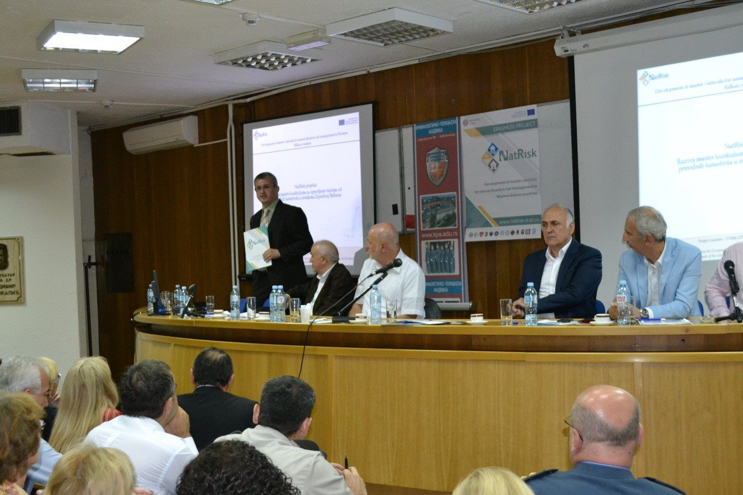
Development of master curricula for natural disasters risk management in Western Balkan countries
NatRisk Promotion
Round table: Resilience as the basis of a security culture in Belgrade, Serbia – May 2017

Slide 25
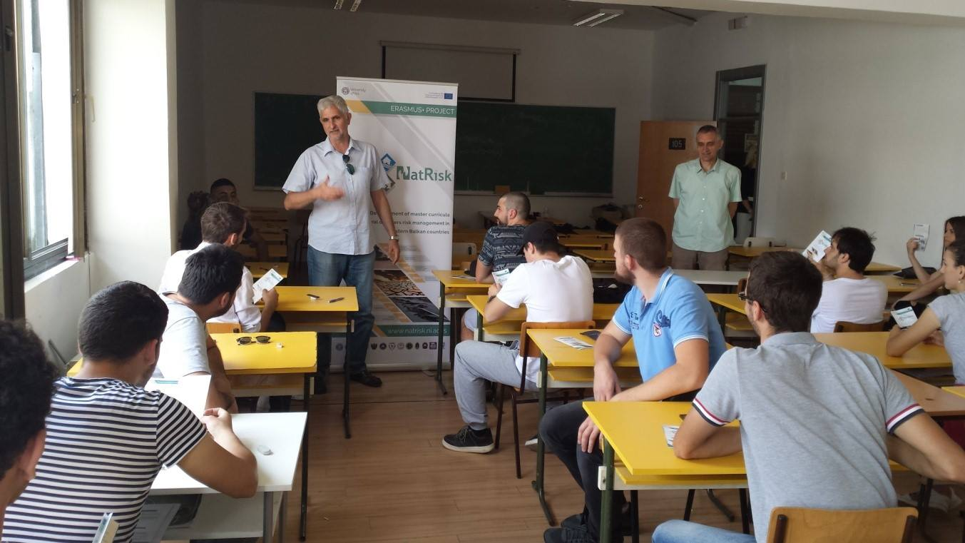
Development of master curricula for natural disasters risk management in Western Balkan countries
NatRisk Promotion
University of Montenegro – June 2017

Slide 26
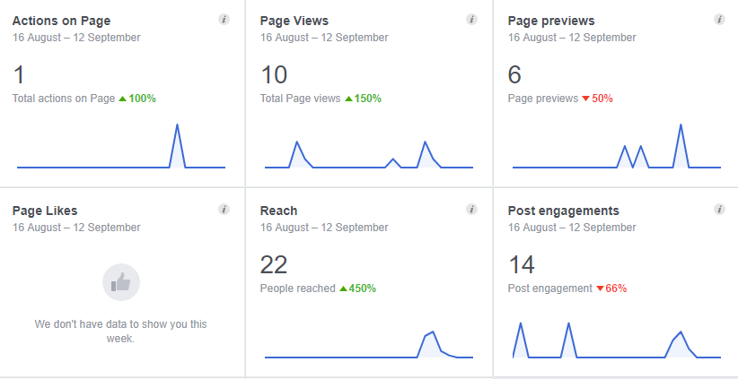
Development of master curricula for natural disasters risk management in Western Balkan countries
Facebook analytics

Slide 27
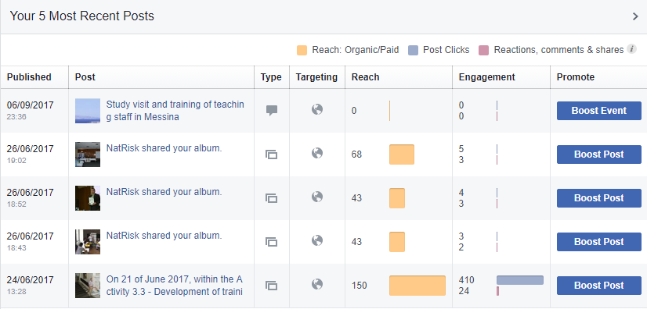
Development of master curricula for natural disasters risk management in Western Balkan countries

Slide 28
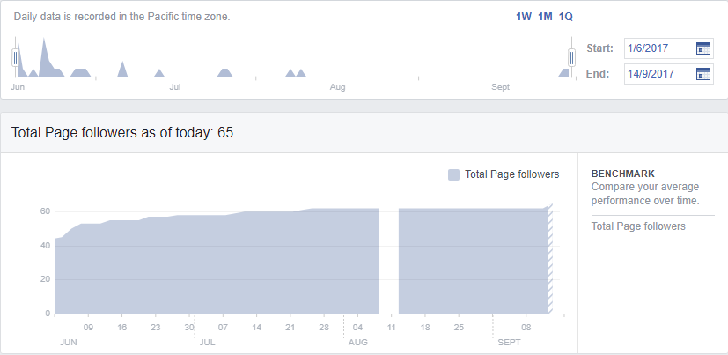
Development of master curricula for natural disasters risk management in Western Balkan countries

Slide 29
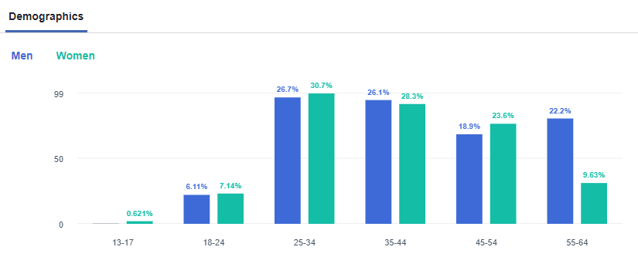
Development of master curricula for natural disasters risk management in Western Balkan countries

Slide 30
Conclusion
Development of master curricula for natural disasters risk management in Western Balkan countries
LFM matrix specifies following objective indicators for dissemination:
  Web site developed since November 2016 – accomplished.
  Dissemination Plan created by March 2017 - accomplished.
  Promotion material created since March 2017 - accomplished.
According to these indicators, it can be concluded that dissemaination activities are performed successfuly and on time.

Slide 31
Thanks for your attention!!!
Development of master curricula for natural disasters risk management in Western Balkan countries

